Slide 1

BUFC Quant Project
DATE: 12/01/2022
Statistical Arbitrage/Pairs Trading
Made By Nikhil Ramchandani

Slide 2
Table of Content
DATE: 12/01/2022
What is Pairs Trading
Definition of Pairs Trading
Correlation
Cointegration
Z-Score
Trading Strategy
Rolling Data
Buy Cycle
Sell Cycle
Results
Implementation
Total Return
Return Vs Market Performance
Evaluation
Reflection
Potential Improvements

Slide 3
Trading strategy that involves matching a long position with a short position in two stocks with a high correlation.
Definition of Pairs Trading
Centered around stocks with high correlation
In theory, two stocks that have a strong positive correlation, i.e., Coke & Pepsi, price movements should follow each other
Short and long positions are taken when a stock is overvalued with respect to the ‘paired’ stock
Correlation
The correlation is calculated with the covariance and standard deviation
Correlation constant ranges from -1 to 1, as the absolute value of the constant approaches 1, a stronger correlation is presented.
A positive value represents a positive correlation while a negative value represents a negative correlation (i.e when the sock price of A increases, the stock price of B decreases)
Z-Score
a numerical measurement that describes a value's relationship to the mean of a group of values
Z-score is measured in terms of standard deviations from the mean. If a Z-score is 0, it indicates that the data point's score is identical to the mean score.

Slide 4
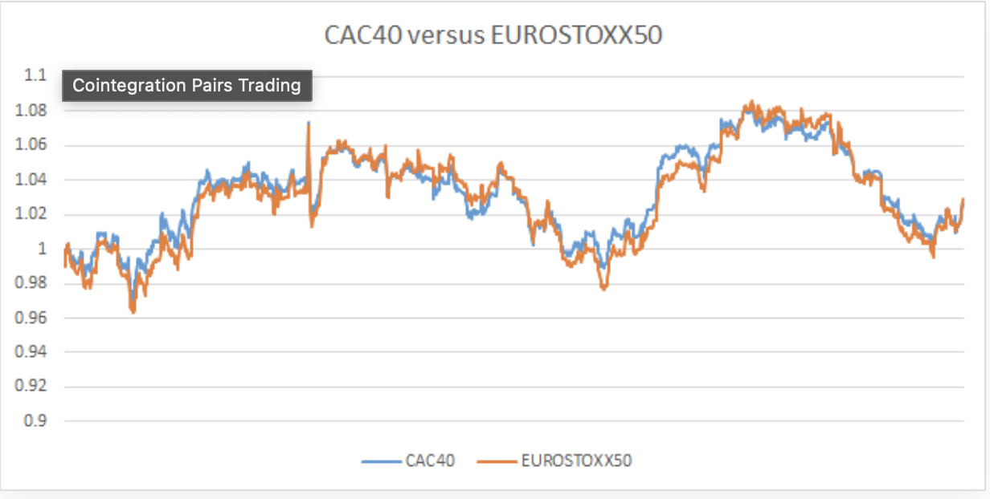
Cointegration
DATE: 12/01/2022

Slide 5
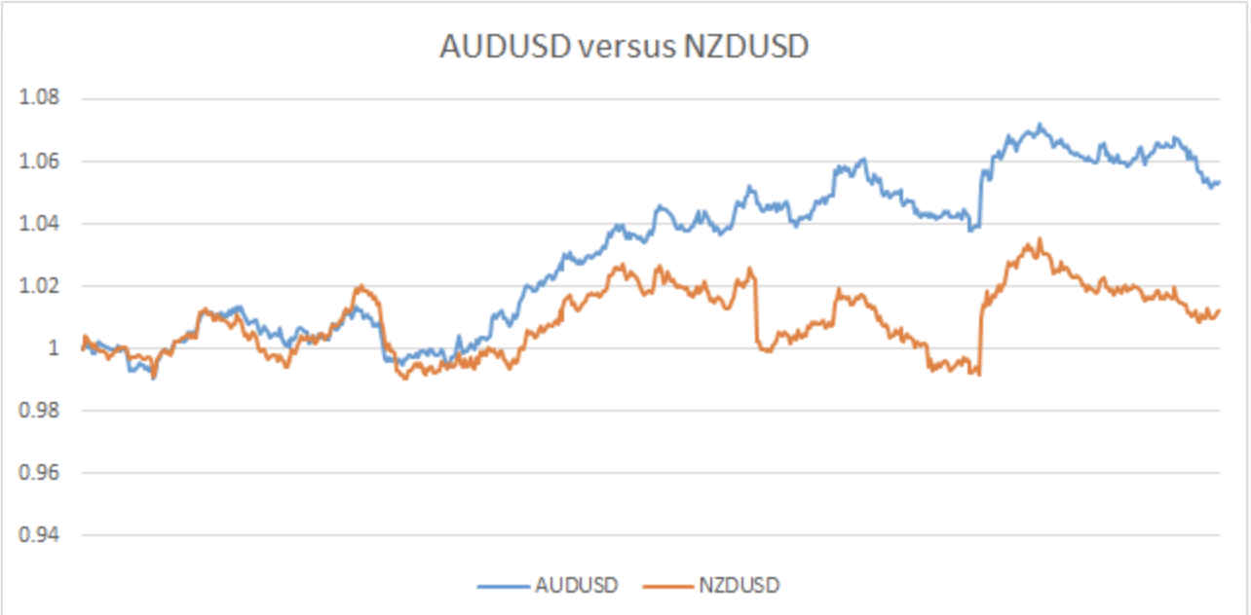
Correlation
DATE: 12/01/2022

Slide 6
Trading Strategy
DATE: 12/01/2022
Developing Indicator
Calculate price difference of the two stocks at the adjusted close for the time period of 2012 to 2022
Calculate 30 day rolling average and standard deviation of the price difference
Z Score Formula: (Actual Price Difference – 30 Rolling Average Price Difference)/ Actual Price Difference
Buy/Sell Signal
Buy Signal:
Precondition: Today’s adjusted closing can not be over 10% less than yesterday price
Buy signal check
Z Score > Threshold : long Coke and short Pepsi
Z Score < -Threshold : short Coke and long Pepsi
Z Score within -Threshold to Threshold: No Trade
Sell Signal:
Two variables: Base value and Current Value
Both base value and current value start at 1
If current value is 5% greater than its original value, base value = base value
If current value is 5% less than base value, sell signal will be triggered

Slide 7
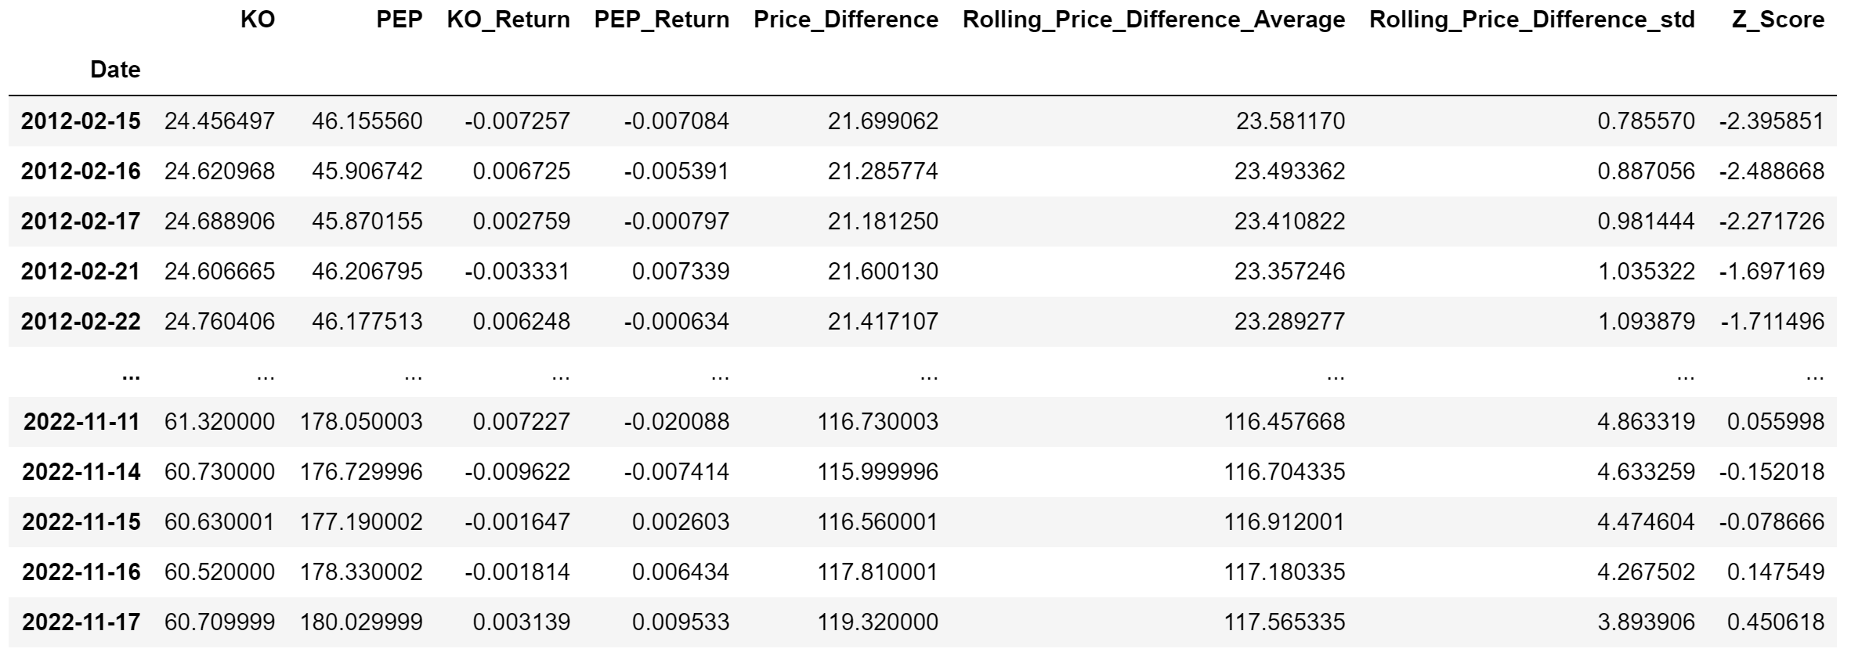
Implementation
DATE: 12/01/2022
Information in The Dataset
Stocks: Coke & Pepsi
Start Date: 2012-01-01, End Date: 2021-12-31
Daily Return: (Today Price – Yesterday Price)/Yesterday Price
Days of rolling average and standard deviation: 30
Z Score Formula: (Actual Price Difference – 30 Rolling Average Price Difference)/ Actual Price Difference

Slide 8
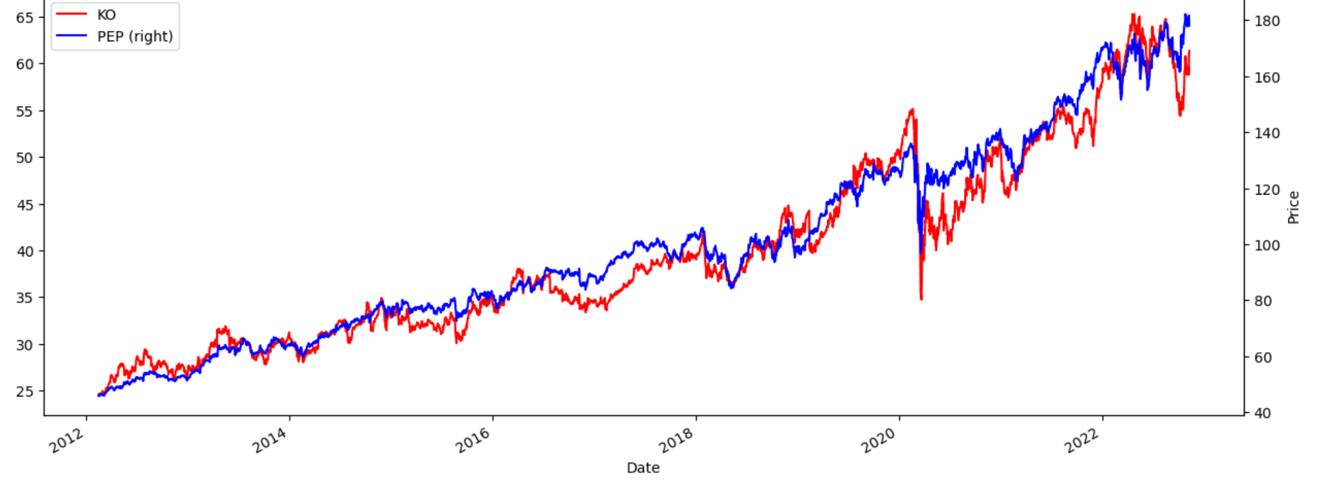
BUFC Quant Project
DATE: 12/01/2022
KO and PEP Stock Price Movement

Slide 9
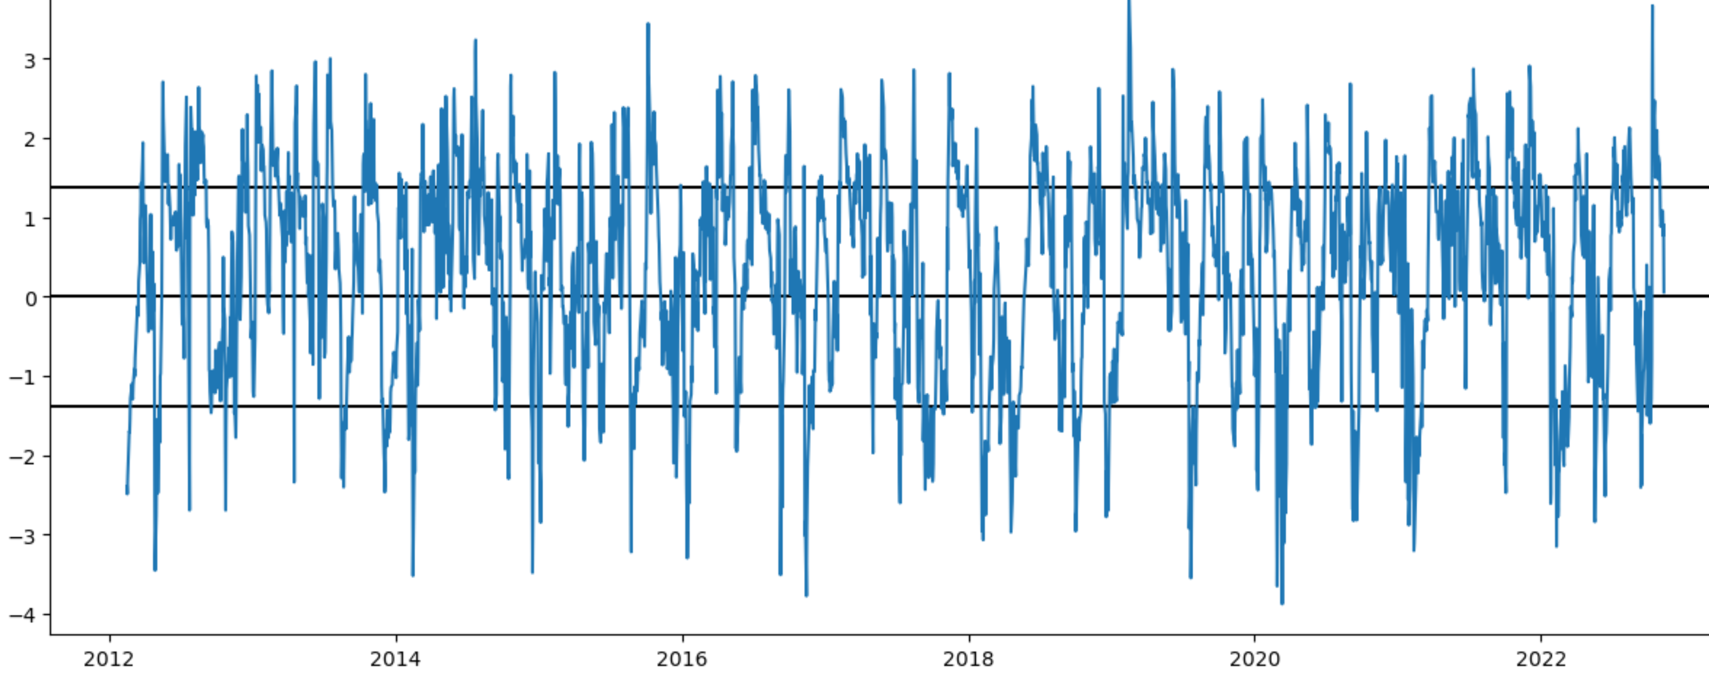
BUFC Quant Project
DATE: 12/01/2022
Z Score Distribution

Slide 10
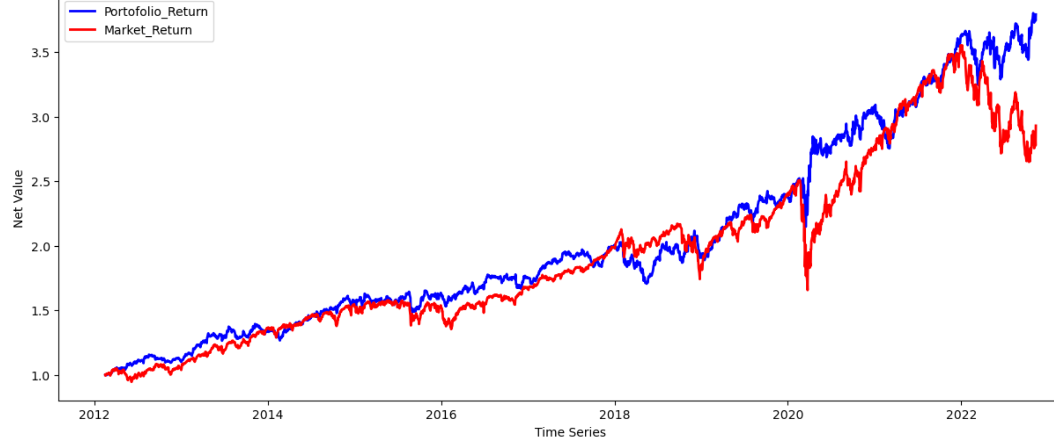
BUFC Quant Project
DATE: 12/01/2022
Portfolio Return vs Market Return

Slide 11
BUFC Quant Project
DATE: 12/01/2022
Statistical Summary
Market Annual Return : 11.35%
Portfolio Annual Return= 14.25%
Exceed Market By = 2.90%

Slide 12
BUFC Quant Project
DATE: 12/01/2022
1
Varying Stocks
2
Extended Theories : Kalman Filters

Slide 13
BUFC Quant Project
DATE: 12/01/2022
Statistical Arbitrage/Pairs Trading
Made By Nikhil Ramchandani

